Slide 1
R Data Structures
Data Structures: Organizing and Storing of Data
vector
matrix
data.frame
factor
list

Slide 2
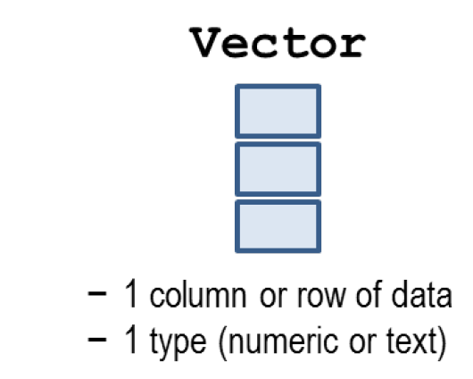
R Data Structures: Vector

Slide 3
R Data Structures: Vector
1-dimensional collection
Homogenous data
1.2, 2.7, 3.6, …
“Jack”, “Rose”, “Josie”, …
TRUE, FALSE, FALSE, …
1.2, “Jack”, TRUE, … is NOT possible
c() – construct a vector
length() – number of elements

Slide 4
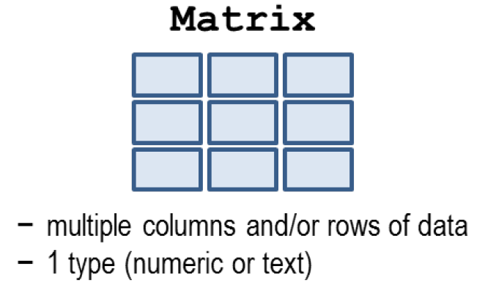
R Data Structures: Matrix

Slide 5
R Data Structures: Matrix
2-dimensional collection
row (horizontal), column (vertical)
Homogenous data
matrix(), rbind(), cbind() – constructs matrix
dim(), nrow(), ncol() – gives dimension

